Slide 1

CSL-220: Database Management Systems Lab
LAB # 3
SINGLE ROW FUNCTIONS
Instructor: Engr. Hareem Fatima

Slide 2
SINGLE ROW FUNCTIONS
Single-row functions in SQL operate on single rows to produce a result based on each row. Some of them are enlisted below.
Numeric Functions
Character/String Functions
Date Functions
Conversion Functions
General/Miscellaneous Functions

Slide 3
NUMERIC FUNCTIONS
Numeric functions in SQL operate on numeric values and return a numeric result.
ABS(x): Returns the absolute value of x.
CEIL(x) / CEILING(x): Returns the smallest integer greater than or equal to x.
FLOOR(x): Returns the largest integer less than or equal to x.
ROUND(x,n): Rounds x to n decimal places (default is 0).
SQRT(x): finding square root of a number.

Slide 4
CHARACTER/STRING FUNCTIONS
Character functions accept character inputs and can return either characters or number values as output.
Example:
UPPER(string): Converts all characters in a string to uppercase.
LOWER(string): Converts all characters in a string to lowercase.
LENGTH(string): Returns the length of the string.
CONCAT(string1, string2): Concatenates two strings.
CHARINDEX(‘string to be searched’, col): Return the numeric position of a named character.
REPLACE(string, from, to): Searches a text expression for a character string and, if found, replaces it with a specified replacement string.
SUBSTRING(string,x,n): Is used to extract a specific part of a string.

Slide 5
DATE FUNCTIONS
Operate on values of date data.
GETDATE(): Returns the current date and time.
DATEADD(): Adds month, day or year to specified date.
DATENAME(): returns the name of the specified date or time part (e.g., month name, day name).It provides a more human-readable output.
DATEPART():return the integer value of a specified part of a date. It returns an integer representing the specified date or time.
DATEDIFF(): difference between the dates.
FORMAT(date, format): Converts a date or timestamp to a specified format.

Slide 6



EXAMPLES
select
DATEADD(month, 2, '2-19-2025') AS twomonthsahead,
DATEADD(DAY, 2, '2-19-2025') as twodaysahead,
DATEADD(YEAR, -2, '2-19-2025')as twoyearsago;
select
DATENAME(MONTH, '2-19-2025') AS CurrentMonth,
DATENAME(DAY, '2-19-2025') AS CurrentDate,
DATENAME(WEEKDAY, '2-19-2025') AS CurrentDay,
DATENAME(YEAR, '2-19-2025') AS Currentyear;
select
DATEPART(MONTH, '2-19-2025') AS CurrentMonth,
DATEPART(DAY, '2-19-2025') AS CurrentDate,
DATEPART(WEEKDAY, '2-19-2025') AS CurrentDay,
DATEPART(YEAR, '2-19-2025') AS Currentyear;

Slide 7

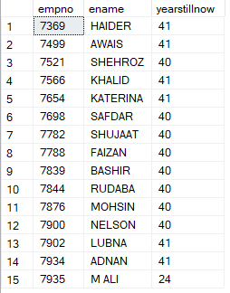
EXAMPLES
SELECT
DATEDIFF(HOUR, '2-18-2025', GETDATE()) as hours,
DATEDIFF(MINUTE, '2-18-2025', GETDATE()) as minutes,
DATEDIFF(SECOND, '2-18-2025', GETDATE()) as seconds;
select empno, ename,
datediff(year, HIREDATE, GETDATE())
as yearstillnow from emp;

Slide 8
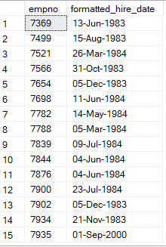
EXAMPLES
SELECT empno, FORMAT(hiredate, 'dd-MMM-yyyy') AS formatted_hire_date FROM emp;

Slide 9
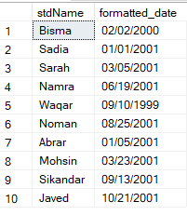
CONVERSION FUNCTIONS
Conversion functions in SQL are used to convert one data type to another. These functions help ensure compatibility between different data types within SQL queries.
CAST(x):
CONVERT(): (especially for dates).
both can be used for data type conversion and formatting
Example:
SELECT stdName,
CONVERT(VARCHAR, StdDOB, 101)
AS formatted_date FROM std;

Slide 10
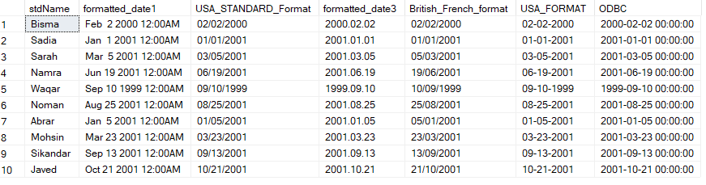
SELECT stdName,
CONVERT(VARCHAR, StdDOB, 100) AS formatted_date1,
CONVERT(VARCHAR, StdDOB, 101) AS USA_STANDARD_Format,
CONVERT(VARCHAR, StdDOB, 102) AS formatted_date3,
CONVERT(VARCHAR, StdDOB, 103) AS British_French_format,
CONVERT(VARCHAR, StdDOB, 110) AS USA_FORMAT,
CONVERT(VARCHAR, StdDOB, 120) AS ODBC
FROM std;

Slide 11
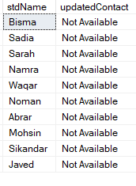
GENERAL/CONDITIONAL FUNCTIONS
These functions perform various operations on data and are often used for data manipulation, conversion, and control flow.
COALESCE (): return the first non-null expression. (It's particularly useful when dealing with nullable columns or situations where you want to provide a default value if a column has a null value.)
EXAMPLE:
SELECT stdName,
COALESCE(stdaddress, 'NotAvailable')
AS updatedContact FROM std;

Slide 12
ISNULL(): Is used to replace NULL values with a specified replacement value. It takes only 2 arguments.
SELECT stdname, ISNULL(stdemail, Stdphone) FROM std;
3. CASE(): conditional expression, similar to the IF-THEN-ELSE structure.
CASE
WHEN condition1 THEN result1
WHEN condition2 THEN result2
ELSE defaultResult
END

Slide 13
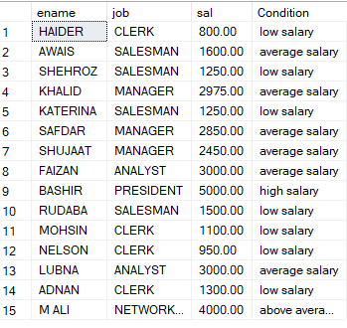
EXAMPLES
select ename, job, sal,
case
when sal between 500 and 1500 then 'low salary'
when sal between 1500 and 3000 then 'average salary'
when sal between 3000 and 4000 then 'above average salary'
when sal > 4000 then 'high salary'
else 'lowest salary'
end as Condition from emp;

Slide 14
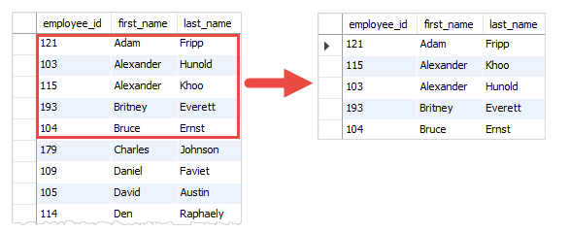
Select top 5 employee_id,first_name,last_name
from employees
order by first_name

